Slide 1
DevOps for ExaScale - ExaSGD’s journey

Slide 2
Table of contents
Introduction
Spack & Dependency Management (Sayef)
Linting / Tooling (Jaya)
CMake, buildsystems, and our C/Python/JS Stack (Cameron)
Template Slides (Section Header)

Slide 3
Introduction

Slide 4
Who are we?
Jaya Preethi Moore
Sayef Azad Sakin
Cameron Rutherford

Slide 5


What is ExaGO?
ExaGO can take networks as large as the continental US…
… and generate information about loads/generators/renewables

Slide 6

SCOPFLOW (Security Constrained OPFlow)

Slide 7
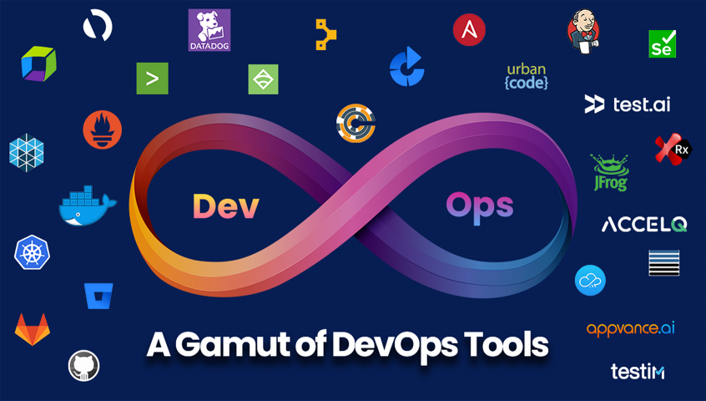
What is DevOps?
DevOps is complicated!

Slide 8
Exascale? ExaGO? ExaSGD?
TODO - add video in slides manually.
https://www.youtube.com/watch?v=HmQjMEPhfDM
Assembly video of Frontier, #1 on the top 500. https://www.top500.org/lists/top500/2023/06/
ExaSGD requires ExaGO to be built with a variety of dependencies, and to run on anywhere from a Mac to the world’s largest computer.

Slide 9
Spack & Dependency Management (Sayef)

Slide 10
HPC or cloud based applications has lots of dependencies
ExaGO depends directly on 55 packages with 598 other packages.
Total interdependencies among the packages amounts to 5480, depending on platforms, compilers and other software configurations.

Slide 11
Graph of dependencies is a nightmare
ExaGO packages Dependencies

Slide 12
GitLab CI/CD Helps
spack: specs: - exago@develop+cuda%gcc@10.2.0 cuda_arch=60,70,75,80 - exago@develop+cuda%gcc@10.2.0 cuda_arch=60,70,75,80 view: false concretizer: unify: when_possible reuse: true config: concretizer: clingo
Here is some the spack spec install of exago in GitLab CI/CD. These pipelines are invaluable in automating the testing and deployment of our code.

Slide 13
Package managers
source code to binary for reproducibility and performance
portable binary
compiler and runtime libraries
Spack manages dependencies

Slide 14
Useful Spack commands
edit packages
spec
concretize
install

Slide 15
Some other Spack features
Environments
Mirrors (with E4S.)
Binary hashes, reuse

Slide 16
Spack supported profiling efforts
TODO

Slide 17
Linting / Tooling (Jaya)

Slide 18
Linting is a code analysis process to check for potential erros and compliance issues.
Gitlab is one of the CI/CD tools for linting that supports linting/devops operations on different languages.
Docker, Kubernetes, and Singularity are few of the contenarization and orchaestration tools to support devops workflows for HPC software package maintainance.
These tools enhances devops workflows with software code testing, bug identification, maintainance and colloboration.

Slide 19
Linting @ExaSGD Devops workflows
current linting (clang format, python format, file naming conventions, cmake format), run in CI pipelines for checking, can run manually to make in place changes.
Transition to precommit for linting influnces various capabilities and ease of working.
Pre-commit testing detects the presence of bugs on configuration and the other project source files.
It can be applied to the linting formats (clang format, python format, file naming conventions, cmake format).

Slide 20
Pre-commit
TODO

Slide 21
Documentation
TODO

Slide 22
CMake, buildsystems, and our C/Python/JS Stack (Cameron)

Slide 23
Language interoperability refers to a combination of different programming languages to select the most suitable programming language for efficiency.
Due to the limitations and difference in different programming languages the language interoperability becomes challenging in certain times.
C, Python and Java Script are the programming languages considered for the language interoperability in ExaSGD project.
Python wrapper can interact with modules consists of C, Java Script and Python scripts in the working directory.

Slide 24
Language interoperability between C, Python and JS (Cameron)
ExaGO’s code base is based in C++
The ExaGO Python bindings use an object-oriented API slightly different from the C++ API.
The C++ API uses the application type in uppercase as the prefix for its methods, where they are native methods in Python. pybind11 + pytest

Slide 25
Slide 2
This year, we have introduced new Python bindings for ExaGO using pybind11 for the wrapper and pytest for the test suite. We have achieved coverage of the main OPFLOW functionality and use mpi4py to allow the Python module to interact with MPI.

Slide 26
Test 9
The Spack package is aware of these bindings and will install the Python dependencies when the appropriate options are enabled. To configure our testing for the Python bindings, we used pytest as a testing framework and then ran these tests within CMake.

Slide 27
Slide 3
This way, the dozens of unit tests for each Python application supported only show up as one test in any ctest run. We test two ways - one with MPI initialized in Python and the other with MPI initialized through ExaGO’s initialization function. These pipelines are run independently from the C++ tests in GitLab CI pipelines and allow the development of the more experimental Python wrapper to go along with core C++ work without interrupting the success of CI pipelines.

Slide 28
Slide 4
added coverage of the SOPFLOW and SCOPFLOW applications in the Python wrapper, and so this testing infrastructure choice further supported parallel development.

Slide 29
Cloud application / Frontend + LLM
Some notes from Sichen with screenshots of progress, and rough arch outline?

Slide 30
Notes:
Any Questions?

Slide 31
Template Slides (Section Header)

Slide 32
Two Content
Put the larger image in the first element, and the smaller text in the second.
US Network

Slide 33
Comparison
Test
Test 123
US Network

Slide 34
Content With Caption
Content with caption? Note the empty line between the two, and the (caption on top?)

